Slide 1
The New NIH biosketch
An opportunity to communicate key concepts to reviewers
Ruth Greenblatt
Dept of Clinical Pharmacy
UCSF

Slide 2
The new NIH biosketch
Limited to 5 pages, including support
Continues personal statement
List of positions and honors
New contributions to science
Research support, including roles, and in order of relevance to the proposed project
You need an eRA commons name

Slide 3
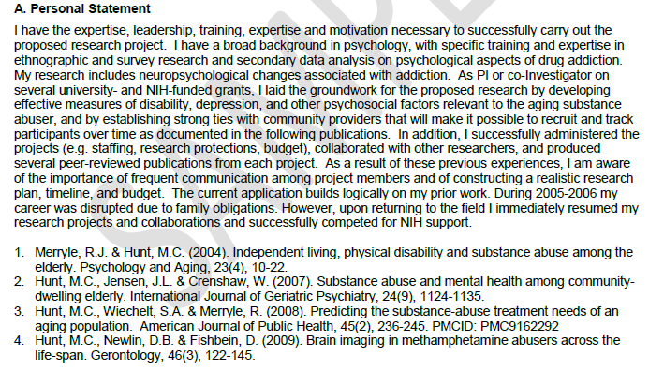
Personal Statement
Do not reuse boilerplate text from project to project
Write about how you are qualified for the role you will play in the proposed research, why you think it is important, and any other message you want to send reviewers
You can include the most relevant publications here
You need to do this yourself, pre-award staff will not have the knowledge you have to tailor this material to the proposal

Slide 4
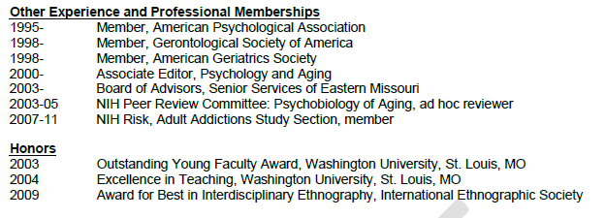
Positions and Honors
Include current position, memberships and recent honors
You can indicate that these are “selected”
Select items that are most relevant to the proposal
Include Federal committees, particularly recent
If you do not have these kinds of experiences yet, avoid listing more limited awards “most organized post doc” and use the space for your personal statement

Slide 5
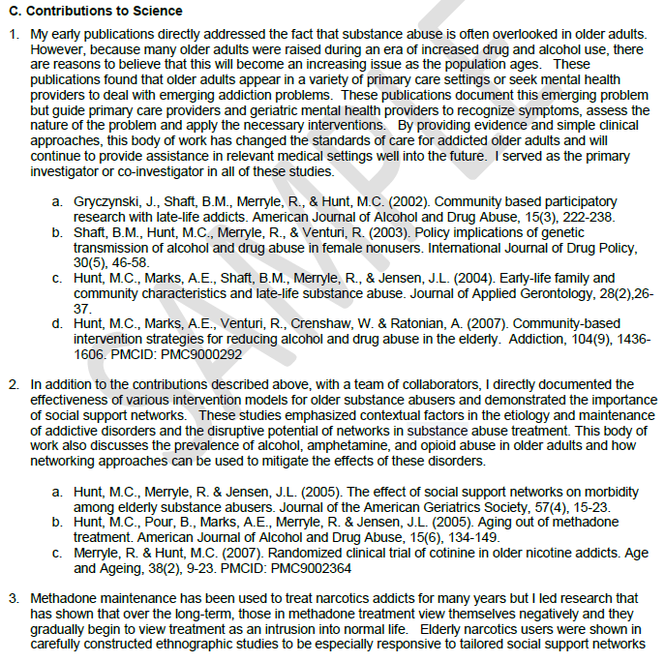
Contributions to science
Select material that supports your role in the proposed research
Indicate what your research was and why it was impactful.
Articulate impact by describing:
How your work changed understanding or confirm important concepts?
How your work influenced treatment, diagnosis, risk assessment, policy?
How your work influenced subsequent studies, research hypotheses or methods

Slide 6
Contributions to science: Highlighted references
For each contribution, list up to 4 publications
Include PMCID for any work published after 2007, or if recent, “PMCID pending”. Up date this next time you submit a biosketch
Do not list in-progress or submitted.

Slide 7
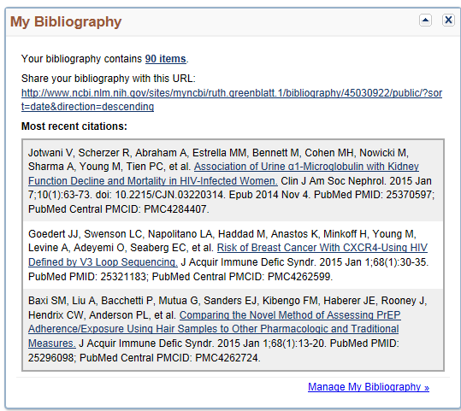
Frustrated by the limit of 4 references?
Utilize “My Bibliography” from NCBI to provide URL linkage to your full list of publications
Insert a URL for your “MyBibliography” page.
This will include all publically available publications since 2008
Those with PMCIDs
Find this on My NCBI
Reach via pubmed, or NCBI website (Natl Library of Medicine)

Slide 8
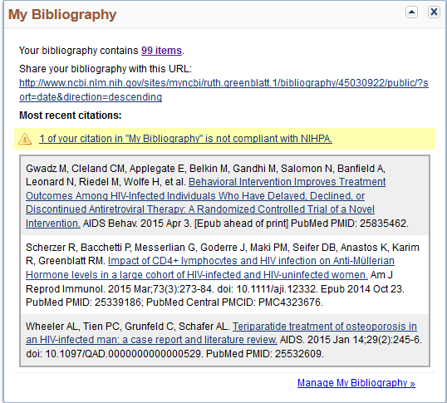
Getting to MY NCBI
Log onto MY NCBI
http://www.ncbi.nlm.nih.gov/sites/myncbi/
Most often use your e-commons user name and password
You will see “Share Your Bibliography with this URL”
Copy the URL and insert into your NIH biosketch

Slide 9
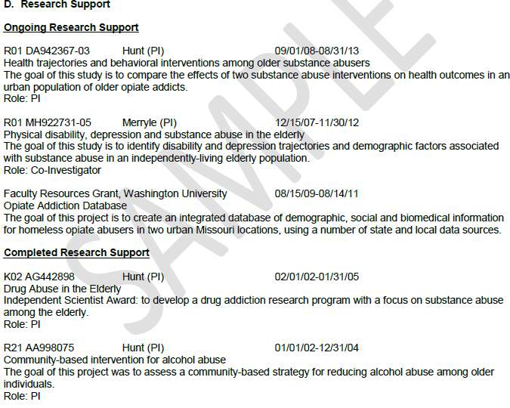
Research support
Does not include % effort, total direct, etc
Includes funding period, your role
You now write a description of the project
Write in order of most relevant to least relevant to proposed research

Slide 10
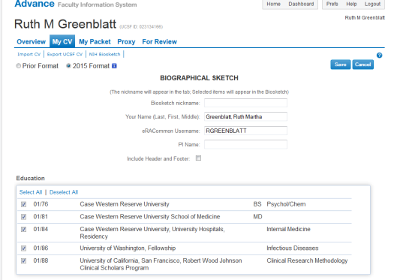
Using online resources to generate a biosketch
UCSF Advance
Go to “My CV”
Select NIH Biosketch
You may see a drop down menu of previous bios you have created
You can create a new one, using check boxes to select contents
SciENcv
Go to My Bibliography
SciENcv box at bottom
You can create multiple profiles
Themes, such as mentoring, different types of work you do

