Slide 1
Research Management Services
Service Partnership Agreement Update
ADD YOUR NAME

Slide 2
Timeline
August 2014: SPA Workgroup Launched
May 2015: Incorporated changes into final draft*
Sept. 2015: SPA training
April 2015: Solicited Feedback from Stakeholders
Feb. 2015: Consensus reached by workgroup
SPA effective date October 1, 2015
August 2011:
RMS Launched
*Minor editorial changes will be accepted and called out in Appendix G: Clarifications to the SPA.
Notes:
RMS launched in 2011. Original RMS Service Level Agreement was put in place February 2012
RMS Satisfaction Survey results echoed RMS Leadership’s note that revisions and updates to the agreement were needed
Workgroup launched in August 2014
Bi-weekly meetings from August 2014 – February 2015
Reviewed SPA sections, made changes, reached consensus on changes
Final review to workgroup to solicit feedback from their stakeholders (April 2015)
Our workgroup members and their associates spent significant time and effort on changes
Other groups that have provided feedback:
Research Administration Think Tank
RMS Leadership
Incorporated changes in the final draft (May 2015)
Editorial changes that clarify the process and do not have an impact on roles & responsibilities will be vetted and incorporated into the final document if approved by RMS Leadership. Editorial changes will be called out in Appendix G – Clarifications to the SPA, with the date of the last update shown on the cover page of the SPA.
SPA Training (September 2015)
SPA effective date October 1, 2015

Slide 3
Service Partnership Agreement workgroup
Participants from all 4 schools, faculty, finance staff, department managers, RMS and other key stakeholder staff
Department Managers/Finance staff | Faculty | RMS | Others
Catherine Garzio | Bill Seaman | Marge O’Halloran* | Irene Shin
Christine Razler | Kathy Lee | Martha White | Jim Kiriakis
Georgina Lopez* | Mark Seielstad | Samantha Yee | John Radkowski
Larisa Kure | Ophir Klein
Melissent Zumwalt | Sam Pleasure
Millo Pasquini | Susan Noworolski
Mounira Kenaani | Stuart Gansky
Pat Wirattigowit
Sarah Glass
*SPA workgroup co-chair

Slide 4
Key Themes
Key themes reflected throughout the updated Service Partnership Agreement:
Underlining the relationships between key parties (PI, RMS, department and CGA)
Accurately reflect the current process
Clarified roles and responsibilities
Focus on consistent service across all of RMS

Slide 5
Continuing RMS Services
RSCs continue to lead the following processes under the 2015 Service Partnership Agreement:
Compiling and submitting grant proposals, including budget development
Supporting awards, including outgoing subcontracts and progress reports
Communication and collaboration with sponsors and internal administrative services

Slide 6
Additions to RMS Services
The 2015 SPA includes additional sections to reflect RMS’ role in award acceptance as of April 2014:
Award Triage – RMS Triage enters award into CACTAS, assigns to RSC and notifies Department & PI within 48 hours.
Award Intake –RSC initiates compliance check within 5 days of assignment.
Negotiation –RSC will request changes to Sponsor terms & conditions if necessary while coordinating with and updating PI and Department.
Award Setup – RSC routes executed awards to CGA in CACTAS for RAS setup and COA assignment within 2 days of finalized agreement.

Slide 7
Additions to Roles & Responsibilities
Further defined the pre-award process by adding procedures that were previously omitted:
Just-In-Time
Transfer Awards In
Biosketch

Slide 8
Highlights & Key Changes
Other Support
Progress Report Reminders
PubMed Central Identifiers (PMCIDs)
Award Advances
Carryforwards, Re-budgeting Awards & Changes in Personnel on Awards
T32s & Other Project-Specific Tables/Lists

Slide 9
Highlights & Key Changes Other Support
Previously the RSC reviewed Other Support for completeness and consistency with UCSF records, communicated discrepancies to the Department and participated in resolution.
It was agreed that it would be more efficient for Departments to own Other Support content, with RSCs providing relevant grant information and translating information into Sponsor-specific formatting.
RSCs will now be sending updates on pending proposals when grants are submitted.

Slide 10
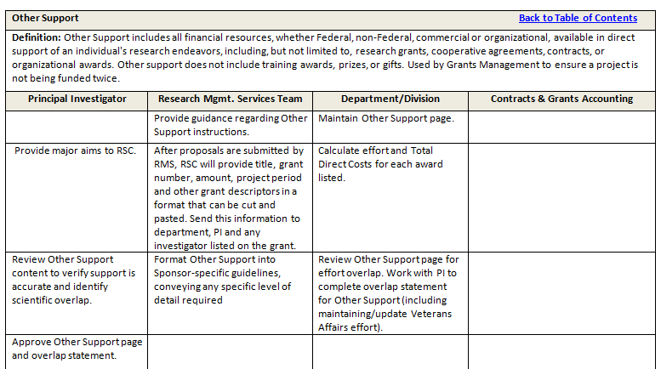

Slide 11
Highlights & Key Changes Progress report reminders
Previously RMS was responsible for notifying PIs and post-award staff of upcoming progress report deadlines.
Now the Department notifies RMS of upcoming progress report deadlines.
PeopleSoft will be updated in March 2016 to include progress report milestones.

Slide 13
Highlights & Key Changes PubMed Central Identifiers (PMCIDs)
Updated to include PMCIDs responsibilities in regards to biosketches.
After much discussion, it was decided that PMCIDs sit with the PI and designated administrative staff, if available.

Slide 14
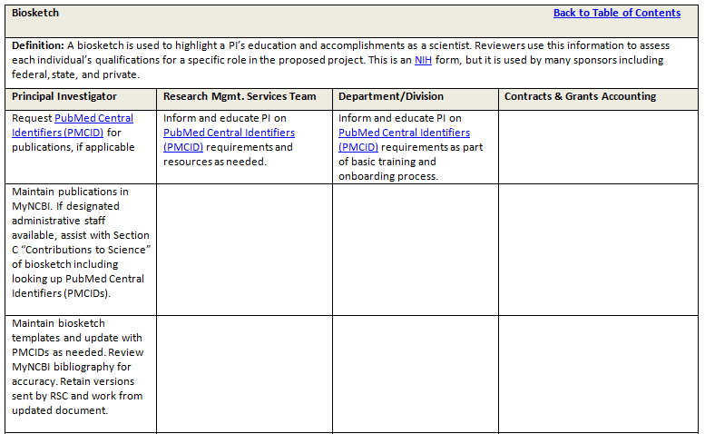

Slide 15
Highlights & Key Changes Award Advances
Previously the Department requested an award advance from the RSC, who completed the form and obtained signatures.
Now the Department completes the award advance form and submits to the RSC for compliance review.

Slide 17
Highlights & Key Changes Carryforwards, Re-budgeting Awards & Changes in Personnel on Awards
Roles & responsibilities were defined and standardized across these processes.
Post award will provide the financial data for the request in the form of BSR, spending plan, or other applicable format.
RSC will translate financial data into the Sponsor-specific format and submit the request to the Sponsor.
The PI is responsible for drafting the scientific justification for the request.

Slide 18
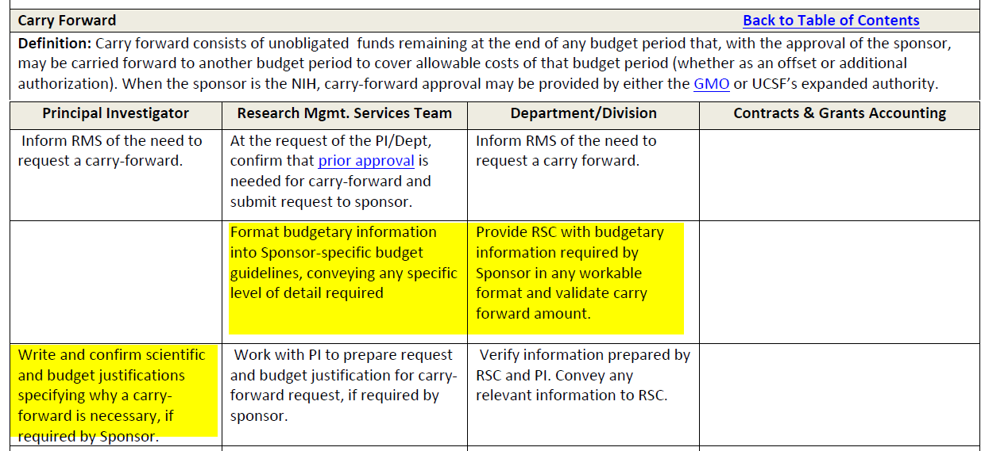

Slide 19
Highlights & Key Changes T32s & Other Project-Specific Tables/Lists
Department is responsible for the information and formatting of T32 tables and other project-specific tables and lists required by the Sponsor, such as publications resulting from the grant or pictures where the Sponsor logo is displayed.
From “Create a Proposal” (p.9):

Slide 20
Sub-Outs
When the SPA was developed, the Sub-Out Team was undergoing a Business Process Improvement (BPI) evaluation.
The new SPA is silent on Sub-Outs, pending the outcome of the evaluation.
The BPI evaluation is now complete and we are piloting a new service model with three teams.
If the new service delivery model is successful, it will be implemented across UCSF. The major shift for Departments will be that the Sub-Out Team will accept Sub-Out Request Forms only from RMS.
RMS will complete the Sub-Out request Form and gather required documentation in partnership with post-award staff.

Slide 21
Training Plan
Website: Update the Office of Sponsored Research’s website.
Resources: Create personalized highlight sheets that emphasize changes for RSC, PIs and Departments.
Job Aids: Provide job aids for key topics (e.g. how to do Other Support).
Live Training: Training developed and conducted by OSR training specialists and representatives of the departments will be provided at Mission Bay, Parnassus and Laurel Heights.
Initial training will focus on Other Support Documents, All Personnel Reports, Effort Reporting and Biosketches.
Future training for T32s, K Awards, and other topics TBD.
Training will be captured as a webinar for later viewing

