Slide 1
NIH Biosketch and Other Support Updates
Office of Sponsored Research
Operations and Training Team:
Catherine Dunn, Joyce Abe and Kassie Obelleiro
osrinfo@ucsf.edu
4/28/2021

Slide 2
Housekeeping
This slide deck is from a presentation given to the UCSF campus on April 28, 2021.
The information and scenarios provided below are based on the Policy, Guidance and FAQs provided by NIH
Please be aware that NIH may update or modify that guidance.
Check the OSR website for changes https://osr.ucsf.edu/other-support

Slide 3
Learning Objectives
01
Be aware of the changes to NIH Biosketch and Other Support Requirements effective 5/25/21
02
03
Understand what supporting documentation is required for Foreign Support and Appointments
Know the NIH requirements in relation to the OS template format
04
Know what types of support should be included in the different sections of the Biosketch and Other Support
05
Understand the internal UCSF process for Other Support
07
Know how to access NIH and OSR resources
06
Know that the PI and all other Senior/Key Personnel must sign their OS

Slide 4
NOT-OD-21-073
Upcoming changes to Biographical Sketch and Other Support Format Page for Due Dates on or after May 25, 2021
Align with other Federal Research Agencies
Following guidance issued by the Office of Science and Technology Policy Joint Committee on the Research Environment
First step to transitioning into SciENcv

Slide 5
NOT-OD-21-073
Upcoming changes to the Biographical Sketch and Other Support Format for Page Due Dates on or after May 25, 2021
For applications and Research Performance Progress Reports (RPPRs) submitted for due dates on or after May 25, 2021.
NOT-OD-21-110: Implementation of Changes (released 4/28/2021):
NIH will not enforce new Biosketch and Other Support Templates until January 25, 2022.

Slide 6
Biographical Sketch

Slide 7
Biographical Sketch Key Changes
Section B: ‘Position and Honors’ renamed to ‘Position, Scientific Appointments and Honors’
Non-Fellowship Biosketch, Section D has been removed
Fellowship Biosketch, Section D renamed Scholastic Performance
Ongoing and completed research (past 3 years) within Section A
Updated Biosketch format available in SciENcv

Slide 8
Section B: ‘Position and Honors’ Renamed to ‘Position, Scientific Appointments and Honors
All positions and scientific appointments both domestic and foreign, including affiliations with foreign entities or governments.
Includes titled academic, professional, or institutional appointments
whether or not remuneration is received, and
whether full-time, part-time, or voluntary (including adjunct, visiting, or honorary)
Notes:
Positions, Scientific Appointments, and Honors updated to read:
List in reverse chronological order all positions and scientific appointments both domestic and foreign, including affiliations with foreign entities or governments. This includes titled academic, professional, or institutional appointments whether or not remuneration is received, and whether full-time, part-time, or voluntary (including adjunct, visiting, or honorary). High school students and undergraduates may include any previous positions. For individuals who are not currently located at the applicant organization, include the expected position at the applicant organization and the expected start date.
- If any of the positions have “research activities” – then also must be included in Other Support – if it is in other support – must be in biosketch. Could be in biosketch but not other support – if there is NO support for research endeavors

Slide 9
Non-Fellowship Biosketch, Section D has been removed
Fellowship Biosketch: Section D. Scholastic Performance
Notes:
Section D – had been the Research Support

Slide 10
Ongoing and Completed Research (past 3 years) Within Section A
Notes:
Instructions for a Biographical Sketch
Personal Statement updated to read:
Briefly describe why you are well-suited for your role(s) in this project. Relevant factors may include: aspects of your training; your previous experimental work on this specific topic or related topics; your technical expertise; your collaborators or scientific environment; and/or your past performance in this or related fields, including ongoing and completed research projects from the past three years that you want to draw attention to (previously known as research support).
The sample provided as it listed in chronological order based on start date. Oldest first.

Slide 11
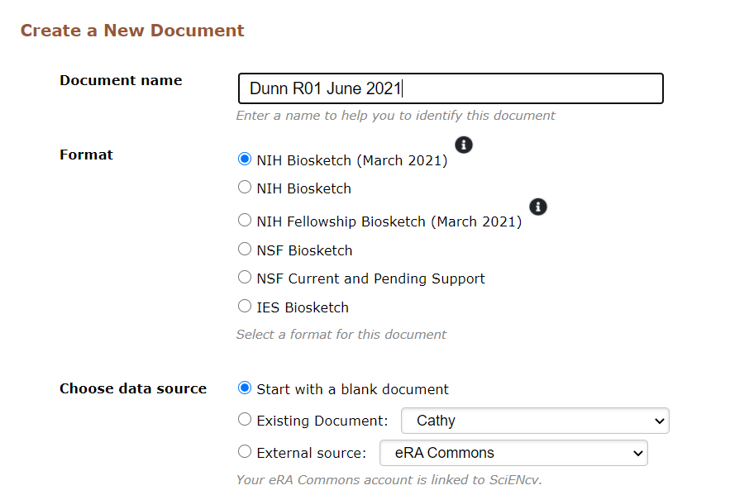
Updated Biosketch Format Available in SciENcv
Notes:
If you select an existing document it will convert to the new format

Slide 12
Updated Biosketch Format Available in SciENcv
Notes:
Point out that there is a link to the full instructions from sciENcv at the top

Slide 13
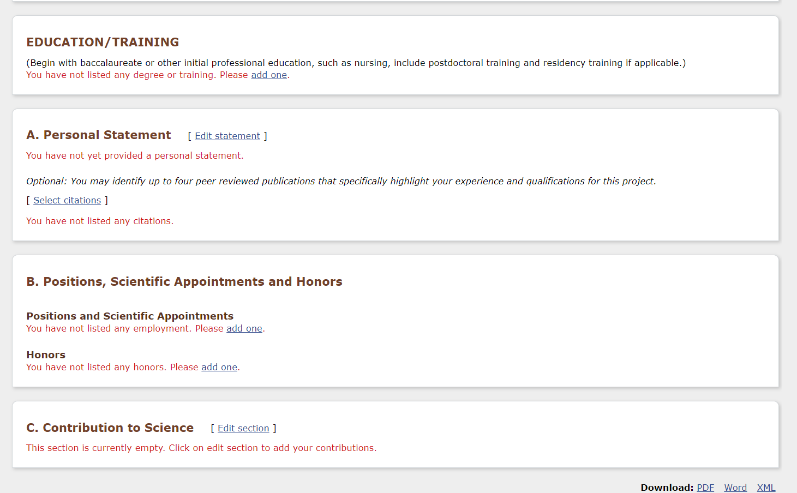
Updated Biosketch Format Available in SciENcv
Notes:
New format in sciENcv

Slide 14
Updated Biosketch Format Available in SciENcv
PI can add a department administrator or lab manager as a delegate
Notes:
Point out that there is a link to the full instructions from sciENcv
Can add a delegate under profile to assist in creating documents

Slide 15
Poll #1
Dr. Chen is a consultant for the Women’s US Soccer team advising on concussion protocols. This is separate from the research she conducts at UCSF and there is no research activities related to the consulting agreement.
Does this belong on their biosketch? If yes, which section?
Answer: Yes, this should go in Section B, Position, Scientific Appointments and Honors
Note: This should also be reported in the OATS system as an outside activity
Notes:
15. Do outside consulting activities have to be reported in Other Support? NEW
Consulting or professional service arrangements that do not involve research do not need to be reported, as the type of work conducted is not typically considered to be a resource available in support of an individual’s research endeavors. When the researcher will be conducting research as part of the consulting activities, they must report it as Other Support.

Slide 16
Poll #2
Dr. Anderson has a joint appointment as a CZ Biohub investigator. The Biohub provides start-up funds to Dr. Anderson.
Does this belong on their Biosketch? If yes, which section?
Yes, this should go in Section B, Position, Scientific Appointments and Honors.
If Dr. Anderson receives additional research support from CZ Biohub, this could also be included in the Section A if desired.
Notes:
16. Should a researcher include start-up support provided by the applicant organization in Other Support? NEW
Start-up packages provided to the researcher from the applicant organization are not included in Other Support. Start-up packages from outside organizations, including foreign entities, must be included in Other Support

Slide 17
Poll #3
Dr. Jackson has a Visiting Lecture position at Peking University. He does not receive a salary and there is no effort commitment. Typically, Dr. Jackson travels to Peking University during the holiday break for 3 weeks and gives multiple scientific lectures regarding the general state of ALS research. Travel is covered and he receives an honorarium.
Does this belong on their Biosketch? If yes, which section?
Answer: Yes, this should go in Section B, Position, Scientific Appointments and Honors
Note: This should also be reported in the OATS system as an outside activity
Notes:
26. I am a Principal Investigator on an NIH award to a domestic university and have an unpaid appointment at a foreign university. At the foreign site I have access to lab space, research materials, and staff. Should I report this as Other Support?
Yes. While the researcher is not receiving monetary compensation, the lab space, materials, and staff are resources made available to them in support of and/or related to their research efforts. Other payments, such as travel or living expenses must also be reported. As outlined in NOT-OD-19-114 this appointment must be reported as Other Support. NIH requires applicants to list all positions and scientific appointments both domestic and foreign held by senior/key personnel that are relevant to an application including affiliations with foreign entities or governments. This includes titled academic, professional, or institutional appointments whether or not remuneration is received, and whether full-time, part-time, or voluntary (including adjunct, visiting, or honorary).

Slide 18
Biosketch Resources
NIH Biosketch Page: https://grants.nih.gov/grants/forms/biosketch.htm
Instructions
Samples
NIH Biosketch FAQs: https://grants.nih.gov/faqs#/biosketches.htm
OSR Biosketch Page: https://osr.ucsf.edu/nih-biographical-sketch-format
Presentation by Dr. Ruth Greenblatt sharing quick tips on how to improve application scores by optimizing use of NIH biosketh format.
NOTE: Recorded for the 2015 biosketch format, but many of the tips are still relevant with the new 2021 format
UCSF OATS: https://ucsf.ucoats.org/
UCSF COI: https://coi.ucsf.edu/
Notes:
Links?

Slide 19
Other Support

Slide 20
NIH Other Support
National Institutes of Health (NIH)
All financial resources, whether Federal, non-Federal, commercial or institutional, available in direct support of an individual’s research endeavors, including but not limited to research grants, cooperative agreements, contracts, and/or institutional awards
Notes:
What

Slide 21
NIH Other Support
National Institutes of Health (NIH)
Excludes:
Training awards
Prizes
Gifts
Start-up support*
Shared facilities or core equipment*
* From NIH Other Support FAQs Q. 16 and 21
Includes:
All foreign and domestic entities
Financial support for laboratory personnel
Provision of high-value materials that are not freely available (e.g., biologics, chemical, model systems, technology, etc.)
Notes:
NIH definition of gift:
resources provided where there is no expectation of anything (e.g., time, services, specific research activities, money, etc.) in return.
21. Do core facilities or shared equipment need to be included in Other Support? NEW
No. Other Support includes resources uniquely available to the researcher and does not include institutional resources that are made broadly available to faculty and staff.
PLEASE NOTE--- IF the shared facility or core is used in the submitted application – must be included in the Facilities and Resource section of the application - we will discuss further later on
16. Should a researcher include start-up support provided by the applicant organization in Other Support? NEW
Start-up packages provided to the researcher from the applicant organization are not included in Other Support. Start-up packages from outside organizations, including foreign entities, must be included in Other Support

Slide 22
NIH Other Support
National Institutes of Health (NIH)
NIH Reviews to ensure:
Sufficient levels of effort are committed to the project
There is no scientific, budgetary, or commitment overlap
Only funds necessary to the approved project are included in the award
Notes:
Why
Other support allows the Sponsor to do an administrative review before an award is issued
Snapshot in time of all the sponsored activities in which identified individuals is engaged
Sponsor use other support to
Identify over=commitment of effort. Note that UCSF faculty cannot exceed 95%
Duplication of support of scientific goals or funding for the same project from other sources
Over Commitment of Key Personnel
More than 100% effort when effort for proposal is added to effort from other research active support
UCSF faculty cannot exceed 95% (11.4 calendar)
In-Residence and Ladder Ranks
Adjunct during any quarter when submitting a proposal

Slide 23
NIH Other Support
National Institutes of Health (NIH)
NIH Reviews to ensure:
All resources, domestic or foreign, directly supporting the individual’s research endeavors have been reported
Any foreign resources that meet the definition of a foreign component have received appropriate prior approval
Notes:
New emphasis in the review
25. What does NIH evaluate when reviewing Other Support submissions? UPDATED
NIH scientific program and grants management staff review Other Support information to ensure that:
All resources, domestic or foreign, directly supporting the individual’s research endeavors have been reported
Sufficient levels of effort are committed to the project
There is no scientific, budgetary, or commitment overlap
Only funds necessary to the approved project are included in the award
Any foreign resources that meet the definition of a foreign component have received appropriate prior approval.

Slide 24
NIH Foreign Components
OS
Adding Foreign Component Requires Prior Approval
Definition
Performance of any significant scientific element or segment of a project outside of the US, either by the recipient or by a researcher employed by a foreign organization, whether or not grant funds are expended
Examples
Extensive travel for data collection, surveying, sampling, and similar activities (would meet definition)
Even informal collaborations with investigators at a foreign site could meet definition.
Activity anticipated to result in co-authorship may be significant activity
Grants Policy Statement sections 8.1.2.10, 1.2
Notes:
Any foreign resources that meet the definition of a foreign component have received appropriate prior approval.
THAT IS NOT OS – How it becomes important in the review. Should either be included in the proposal, or go through the prior approval process to add to the project

Slide 25
NIH Other Support Key Changes
Separate Project/Proposal Section vs. In-Kind Contribution Section
Provide Active, Pending and Completed (within past 3 years)
Report Total Award Amount (with indirect costs)
Report Calendar Months per Budget Period for the Entire Project
Supporting Documentation for Foreign Support/Appointments
Signature of each PD/PI and Senior Key Personnel
Submit Updated Other Support if Undisclosed Support is Discovered
Notes:
Send in updated Other Support

Slide 26
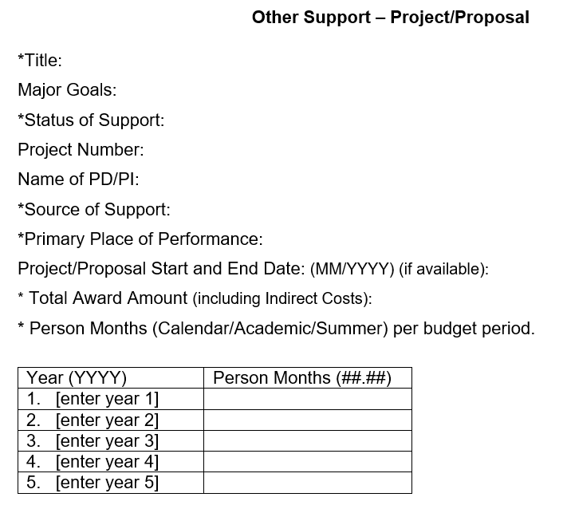
Project/Proposal Section – New Format Page
Active, Pending or Completed (within past 3 years)
Group into sections based on Status of Support
Primary location where project or activity is being executed
Example: University of California, San Francisco
For Active: Total Award based on Notice of Award
For Pending: Based on Proposed Total Costs
For Completed: Not required
For Active: level of effort in person months for current budget period and proposed for future
For Pending: Proposed level of effort for each budget period
For Complete: Not required

Slide 27
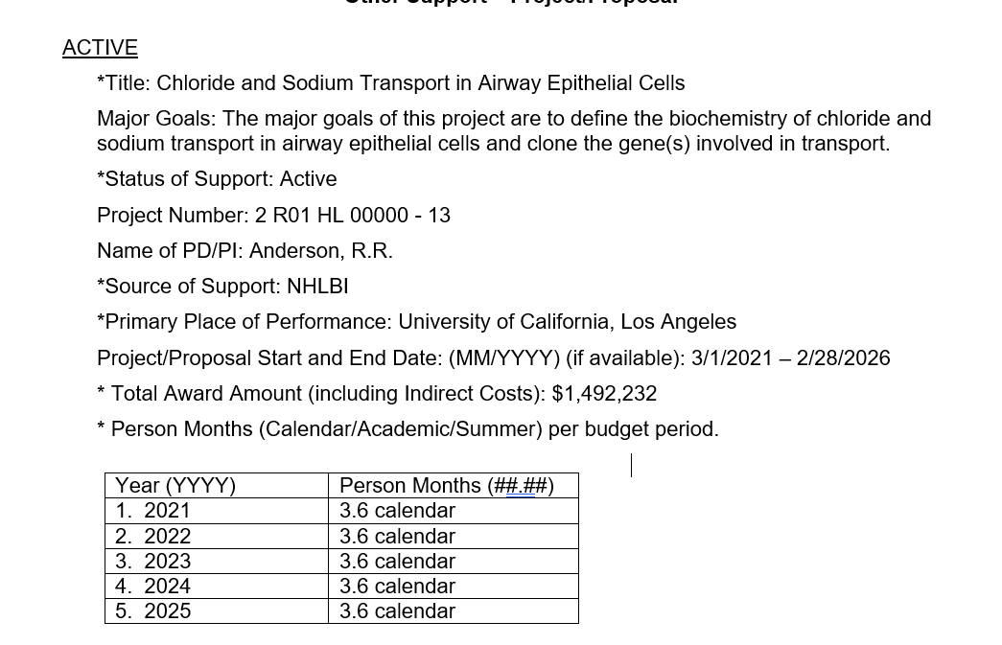
Project/Proposal Section – Sample

Slide 28
Project/Proposal Section – Example Subproject
*Title: Imaging and Tissue Correlates to Optimize Management of Glioblastoma
Major Goals: The overall objective is to integrate advances in physiologic and metabolic imaging with ex vivo biological and genetic information obtained from the analysis of image guided tissue samples in order to optimize the management of patients with glioblastoma (GBM).
*Status of Support: Active
Project Number: 2 P01 CA118816-13
Name of PD/PI: Chang, P.M.
*Source of Support: NIH NHLBI
*Primary Place of Performance: University of California San Francisco
Project/Proposal Start and End Date: (MM/YYYY) (if available): 04/01/2021-03/31/2025
* Total Award Amount (including Indirect Costs) – Project 2: $560,000 and Project 3: $458,315
* Person Months (Calendar/Academic/Summer) per budget period.
Year (YYYY) | Person Months (##.##) Project 2 | Person Months (##.##) Project 3
1. 2021 | 2 calendar | 2.5 calendar
2. 2022 | 2 calendar | 2.5 calendar
3. 2023 | 2 calendar | 2.5 calendar
4. 2024 | 1.5 calendar | 2 calendar
5. 2025 | 1.5 calendar | 2 calendar
Notes:
17. When a researcher is including information on a subproject in Other Support, should the researcher provide the total award amount for the overall award, or only the subproject? NEW
For subprojects, recipients should provide the project number and PD/PI name for the overall project. All other information, including total award amount and person months, for the subproject only.

Slide 29
Project/Proposal Section – Example Subcontract
*Title: Imaging and Tissue Correlates to Optimize Management of Glioblastoma
Major Goals: The overall objective is to integrate advances in physiologic and metabolic imaging with ex vivo biological and genetic information obtained from the analysis of image guided tissue samples in order to optimize the management of patients with glioblastoma (GBM).
*Status of Support: Active
Project Number: 5 R01 CA118816-03
Name of PD/PI: Chang, P.M.
*Source of Support: NIH NCI
*Primary Place of Performance: University of California San Francisco
Project/Proposal Start and End Date: (MM/YYYY) (if available): 05/01/2019-04/30/2023
* Total Award Amount (including Indirect Costs) – Subcontract: 260,009
* Person Months (Calendar/Academic/Summer) per budget period.
Year (YYYY) | Person Months (##.##)
3. 2021 | 4.2 calendar
4. 2022 | 4.2 calendar
5. 2023 | 2.0 calendar
Notes:
18. When a researcher works on a subaward to an NIH grant that is awarded to another institution, how should that information be included in Other Support? NEW
The researcher should provide the project number, PD/PI name for the prime award. All other information, including the total award amount and person months, should be specific the subaward.

Slide 30
In-Kind Contribution Section
External Resources with no dollar amount:
office/laboratory space
equipment
supplies
materials (data, samples, etc.)
employees – including visiting scholars/students working in lab supported by a domestic or foreign entity

Slide 31
In-Kind Contribution Section
Intended for use on the project being proposed
Not intended for use on the project being proposed
Part of the Facilities and Other Resources or Equipment section of the application.
Reported in Other Support

Slide 32
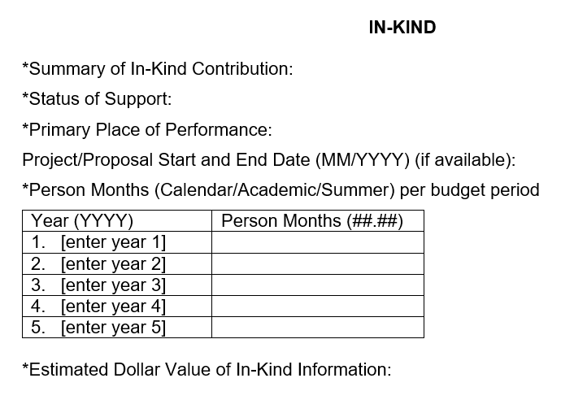
In-Kind Contribution Section – New Format Page
Active and Pending Only
In-kind resources with no associated time commitment, can list zero effort, but must provide the estimated dollar value
The effort and dollar value cannot both be zero
Only resources uniquely available to the researcher must be reported

Slide 33
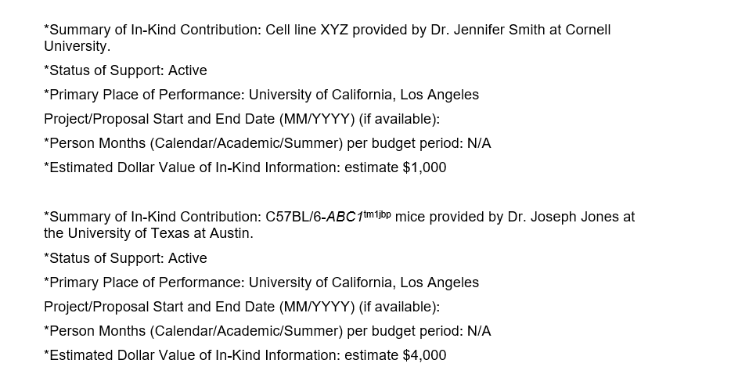
In-Kind Contribution Section – Samples

Slide 34
Supporting Documentation Foreign Support/Appointments
Attach copies of contracts specific to foreign appointments and/or employment with a foreign institution for all foreign activities and resources that are reported in Other Support
If they are not in English, recipients must provide translated copies
Will accept Machine Read Translations
This does not include personal service contracts, or employment contracts for fellows supported by foreign entities
Notes:
7. Are the costs of translating foreign contracts allowable on NIH grants as a direct cost? NEW
The costs associated with translations of foreign contracts for inclusion in Other Support submissions are not typically allocable to a specific NIH grant project and are therefore not allowable as a direct cost. NIH recommends that institutions consider including such costs in their negotiations for indirect cost reimbursement.
2. Does this include employment contracts for fellows or students working in the lab? NEW
No. Personal service contracts for lab staff do not need to be provided. Only contracts, grants and any other agreements specific to the PD/PI or other senior/key personnel’s appointments and employment are required. However, NIH continues to reserve the right to request additional information, as necessary.

Slide 35
Signature of each PD/PI and Senior Key Personnel
Each PD/PI or other senior key personnel must electronically sign their respective Other Support form prior to submission.
Includes Mentors/Co-Mentors on Mentored Career Awards
This signature certifies that the statements are true, complete and accurate.
Notes:
Applicants and recipients must maintain the original electronic signature and make it available upon request.
10. On Mentored Career Awards, mentors/co-mentors are required to submit Current and Pending Support in competing applications. NOT-OD-21-073 indicates that other support must include signatures. Do mentors need to sign the form when reporting current and pending support? NEW
Yes. Attachments should be submitted as a flattened PDF, after all signatures are obtained. Applicants and recipients must maintain the original electronic signature and make it available upon request.

Slide 36
Signature of each PD/PI and Senior Key Personnel
Flatten PDF to be submitted to NIH
Do not send to OSR PDFs that are locked, or secured
Applicants and recipients must maintain the original electronic signature and make it available upon request
Up to department to determine best practice of keeping original electronic copy
Notes:
Applicants and recipients must maintain the original electronic signature and make it available upon request.
14. NIH does not allow electronic signatures on attachments in electronic application attachments. Will electronic signatures be accepted on Other Support submissions? NEW
Other Support submissions at Just-in-Time and in the RPPR must be submitted as a flattened PDF, after all signatures are obtained. Applicants and recipients must maintain the original electronic signature and make it available upon request. When NIH transitions to the use of SciENcv to generate Other Support, the signature/certification will be integrated into that process.

Slide 37
NIH Other Support
Best Practice Timeline
Dept/Div
Add Pending Support provided by OSR
Calculate Effort and Cost for each award
Review for Overlap
Send to PI for review
Dept/Div
Convert to flattened PDF
Save original PDF to provide if requested
Send to OSR
Principal Investigator
Review Other Support Content
Provide any outside UCSF support
Provide any outside UCSF foreign contracts
Identify Scientific Overlap
Sign Other Support Page
RSC/OSR
Review OS for compliance with effort and sponsor requirements
Combine PDFs from all Key Personnel and Submit to sponsor
Upload final packet into eProposal

Slide 38
Poll #4
Dr. Chen is a consultant for the Women’s US Soccer team advising on concussion protocols. This is separate from the research she conducts at UCSF and there is no research activities related to the consulting agreement.
Does this belong on their Other Support? If yes, which section?
Reminder – we previously said it belong on the biosketch
Answer: No, this is not related to research. So does not need to go on Other Support
Source: NIH Other Support FAQ #15
Notes:
15. Do outside consulting activities have to be reported in Other Support? NEW
Consulting or professional service arrangements that do not involve research do not need to be reported, as the type of work conducted is not typically considered to be a resource available in support of an individual’s research endeavors. When the researcher will be conducting research as part of the consulting activities, they must report it as Other Support.

Slide 39
Poll #5
Dr. Chen is a consultant for the Women’s US Soccer team advising on concussion protocols. In addition, Dr. Chen also receives de-identified data that she can use in her research that she conducts at UCSF.
Does this belong on their Other Support? If yes, which section?
Answer: Yes, belongs in the “In-Kind” section of the Other Support since she is receiving data that contributes to her research.
For the data, there should be a data use agreement contract that needs to be reviewed by the OSR – Industry Contracts Division
Notes:
15. Do outside consulting activities have to be reported in Other Support? NEW
Consulting or professional service arrangements that do not involve research do not need to be reported, as the type of work conducted is not typically considered to be a resource available in support of an individual’s research endeavors. When the researcher will be conducting research as part of the consulting activities, they must report it as Other Support.

Slide 40
Poll #6
Dr. Aziz has a Postdoctoral Scholar, James Gordon Ph.D., working in his lab. James Gordon has a stipend and living expenses paid by his home institution, Dresden Technical University, Germany. Dr. Gordon is working on one of the research project in collaboration with others in Dr. Aziz lab.
Does this belong on Dr. Aziz Other Support, if yes, which section?
Yes, it should be reported in the In-Kind section
Source: NIH Other Support FAQ #19
Notes:
19. If a PD/PI or other senior/key Personnel has an exchange student or post-doc working on research activities in their lab who is paid a salary by their home university in a foreign country, does that need to be included in Other Support? NEW
Yes, since the student or post-doc is performing research activities, the student’s work in the lab is a resource available in support of the PD/PI or other senior/key Personnel’s research endeavors. It must be reported as an in-kind contribution on Other Support.

Slide 41
Example of In-Kind
*Summary of In-Kind Contribution: Post-doctoral fellow, Dr. James Gordon, who conducts research activities in the Aziz lab. Stipend and living expenses provided by Dresden Technical University.
*Status of Support: Active
*Primary Place of Performance: University of California, San Francisco
Project/Proposal Start and End Date (MM/YYYY) (if available): 01/01/2020-12/31/2022
*Person Months (Calendar/Academic/Summer) per budget period: N/A
*Estimated Dollar Value of In-Kind Information: $80,000

Slide 42
Poll #7
Dr. Aziz has a Postdoctoral Scholar, James Gordon Ph.D., working in his lab. James Gordon has a stipend and living expenses paid by an American Heart Association fellowship administered through UCSF. Dr. Gordon has a unique project and Dr. Aziz provides guidance to Dr. Gordon.
Does this belong on Dr. Aziz’s Other Support, if yes, which section?
No, if the relationship is solely a mentor/mentee arrangement, with no research activities, it is not a resource and does not need to be reported.
Source: NIH Other Support FAQ #20
Notes:
19. If a PD/PI or other senior/key Personnel has an exchange student or post-doc working on research activities in their lab who is paid a salary by their home university in a foreign country, does that need to be included in Other Support? NEW
Yes, since the student or post-doc is performing research activities, the student’s work in the lab is a resource available in support of the PD/PI or other senior/key Personnel’s research endeavors. It must be reported as an in-kind contribution on Other Support.
20. If a PD/PI or other senior/key personnel is mentoring post-doc or graduate students who are individually funded through an outside institution) e.g. foundation or home university), does that need to be disclosed as an in-kind resource in Other Support? NEW
If the post-doc or graduate student is performing research activities in support of the PD/PI or other senior/key personnel’s research endeavors, then their support must be reported as an in-kind resource. If the relationship is solely a mentor/mentee arrangement, with no research activities, then it is not a resource, and does not need to be reported.
Should I include something about paid direct vs not. I am second guessing this interpretation. I don’t think paid direct makes the difference – it is more the relationship of the mentee’s work to that of the Mentor’s work.

Slide 43
Poll #8
Dr. Anderson has a joint appointment as a CZ Biohub investigator. The Biohub provides start-up funds to Dr. Anderson.
Does this belong on their Other Support? If yes, which section?
Yes, it should be in the In-Kind
Start-up funds provided by applicant organization are not included in Other support. However, start-up packages from outside organization must be included in Other Support.
Source: NIH Other Support FAQ #16
Notes:
16. Should a researcher include start-up support provided by the applicant organization in Other Support? NEW
Start-up packages provided to the researcher from the applicant organization are not included in Other Support. Start-up packages from outside organizations, including foreign entities, must be included in Other Support

Slide 44
Poll #9
Dr. Jackson has an Visiting Lecture position at Peking University. He does not receive a salary and there is no effort commitment. Typically, Dr. Jackson travels to Peking University during the holiday break for 3 weeks and give multiple scientific lectures regarding the general state of ALS research. The travel is covered and he receive an honorarium.
Does this belong on their Other Support? If yes, which section?
Reminder – we previously said it belong on the biosketch
Answer: No, this is not in support or related to their research efforts
Notes:
26. I am a Principal Investigator on an NIH award to a domestic university and have an unpaid appointment at a foreign university. At the foreign site I have access to lab space, research materials, and staff. Should I report this as Other Support?
Yes. While the researcher is not receiving monetary compensation, the lab space, materials, and staff are resources made available to them in support of and/or related to their research efforts. Other payments, such as travel or living expenses must also be reported. As outlined in NOT-OD-19-114 this appointment must be reported as Other Support. NIH requires applicants to list all positions and scientific appointments both domestic and foreign held by senior/key personnel that are relevant to an application including affiliations with foreign entities or governments. This includes titled academic, professional, or institutional appointments whether or not remuneration is received, and whether full-time, part-time, or voluntary (including adjunct, visiting, or honorary).

Slide 45
Poll #10
Dr. Jackson has a Visiting Lecture position at Peking University. He does not receive a salary and there is no effort commitment. Typically, Dr. Jackson travels to Peking University during the holiday break for 3 weeks and give multiple scientific lectures regarding the general state of ALS research. The travel is covered and he receive an honorarium. Additionally, he is provided a lab space to use in order to collaborate with researchers at Peking University. The research conducted is separate from the research he conducts at UCSF.
Does this belong on their Other Support? If yes, which section?
Answer: Yes, lab space does support his research efforts.
Source: NIH Other Support FAQ #26
Notes:
26. I am a Principal Investigator on an NIH award to a domestic university and have an unpaid appointment at a foreign university. At the foreign site I have access to lab space, research materials, and staff. Should I report this as Other Support?
Yes. While the researcher is not receiving monetary compensation, the lab space, materials, and staff are resources made available to them in support of and/or related to their research efforts. Other payments, such as travel or living expenses must also be reported. As outlined in NOT-OD-19-114 this appointment must be reported as Other Support. NIH requires applicants to list all positions and scientific appointments both domestic and foreign held by senior/key personnel that are relevant to an application including affiliations with foreign entities or governments. This includes titled academic, professional, or institutional appointments whether or not remuneration is received, and whether full-time, part-time, or voluntary (including adjunct, visiting, or honorary).

Slide 46
Submit Updated Other Support if Undisclosed Support is Discovered
Immediate notification of undisclosed Other Support.
PI or other Senior/Key personnel on an active NIH grant failed to disclose Other Support information during JIT or RPPR.
Submit updated Other Support to the Grants Management Specialist named in the Notice of Award as soon as it becomes known.
Notes:
This discovery can be by anyone, department, the PI or RSC - any submission of materials to NIH Grants management should go through the SO/AOR.

Slide 47
Updated Other Support Format Available in SciENcv?
NIH anticipates the SciENcv Other Support Template will be available in 2022
Current Word Other Support template is interim until SciENcv template is available

Slide 48
FAQs
What if I am not sure something should be included in the Biosketch or Other Support?
NIH recommends in the interest of full transparency, recipients should err on the side of disclosure.
Are there still 2 different versions of the Other Support, one for Just in Time and one for RPPRs?
No; however, RPPR still only requires the submission of OS if there is a change, or new Key/Senior Key personnel.
Does the Academic Senate 95% rule still apply with the new NIH format?
Yes, be aware of appointment type and clinical, teaching, and/or administrative requirements; effort may need to be capped at 95% (11.4 Calendar months) to allow time for those activities.
Notes:
faculty in the In Residence series must have at least 5% effort from a non-contract or grant source;
faculty in the Adjunct series must have at least 5% effort from a non-contract or grant source in any quarter, in which he/she prepares a proposal.

Slide 49
Other Support Resources
NIH Other Support Page: https://grants.nih.gov/grants/forms/othersupport.htm
Instructions
Samples
NIH Other Support FAQs: https://grants.nih.gov/faqs#/other-support-and-foreign-components.htm
OSR Other Support Page: https://osr.ucsf.edu/other-support
Academic Senate 95% rule: https://osr.ucsf.edu/content/academic-senate-95-rule
Stay Informed:
Join the OSR Announce listserv by email OSRinfo@ucsf.edu
Q&A Sessions: May 11th 2pm-3pm and May 26th 3pm -4pm
https://osr.ucsf.edu/nih-biographical-sketch-and-other-support-town-hall-and-qa-sessions

Slide 50
Learning Objectives
01
Be aware of the changes to the NIH Biosketch and Other Support Requirements effective 5/25/21
02
03
Understand what supporting documentation is required for Foreign Support and Appointments
Know the NIH requirements in relation to the OS template format
04
Know what types of support should be included in the different sections of the Biosketch and Other Support
05
Understand the internal UCSF process for Other Support
07
Know how to access NIH and OSR resources
06
Know that the PI and all other Senior/Key Personnel must sign their OS

Slide 51
For questions regarding policy, please contact:
osrinfo@ucsf.edu
To find your OSR Staff assigned to your department/division:
https://osr.ucsf.edu/content/find-support
This Photo by Unknown Author is licensed under CC BY-SA
Joyce Able
Operations & Training Officer
Catherine Dunn
Operations & Training Officer
Kassie Obelleiro
Operations & Training Officer

Slide 52
Extra Slides

Slide 53
Foreign Influence Across the Lifecycle
Proposal | Just-In-Time | Award Management | Annual and Final Reporting
Identify Investigators working on proposed research Identify if there will be a foreign component | Current and Pending support for PIs and Key Personnel Identify resources available for their research | Review COI and COC to determine if there are potential conflicts Monitor Travel Activity Request prior approval for foreign components | Update Other Support/Current and Pending support Identify and report products and publications

Slide 54
Key Contacts for Foreign Influence Questions
Conflict of Interest
Conflict of Interest Program
COIAC@ucsf.edu
Conflict of Commitment
Outside Activity Tracking System
Dept Chair or academicaffairs.ucsf.edu/oats/
Export Control
International Visitors
Export Control Officer: Brian Warshawsky
ExportControl@ucsf.edu
International Students and Scholars Office
isso.ucsf.edu/isso-team
Notes:
https://www.ucop.edu/academic-personnel-programs/_files/apm/apm-671.pdf
https://ucsf.ucoats.org/

Slide 55
Biosketch Roles and Responsibilities
Service Partnership Agreement
Department | Principal Investigator | Office of Sponsored Research
Inform and educate PI on PubMed Central Identifiers (PMCID) requirements as part of basic training and onboarding process | Maintain biosketch, updating as appropriate for each proposal. Including adding all positions, scientific appointment and honors. Request PubMed Central Identifiers (PMCID) for publications, if applicable | Provide guidance regarding Biosketch Instruction. Request PubMed Central Identifiers (PMCID) for publications, if applicable
Provide research support information if requested by PI | Determine which research support to highlight for each proposal | Review formatting and adherence to sponsor guidelines

Slide 56
Other Support Roles and Responsibilities
Service Partnership Agreement
Department | Principal Investigator | Office of Sponsored Research
Maintain Other Support Page | Provide major aims | Provide guidance regarding Other Support Instruction
Calculate effort and Costs for each award listed and review for effort overlap | Review Other Support content to verify support is accurate and identify scientific overlap | After proposal submitted provided Pending support information
Work with PI to complete overlap statement and to obtain signature | Sign Other Support Page | Format other support info Sponsor-specific guidelines and submit to the Sponsor

